Slide 1
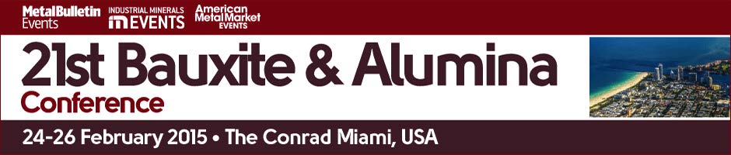
Martin Haller, Haller Metals Economics Limited
Indonesia – one year on from the ban

Slide 2
Disclaimer
The information upon which this presentation is based comes from Haller Metals Economics Limited (HMEL) knowledge and databases. Prices and other information contained in this presentation have been obtained from various sources believed to be reliable.
The opinions expressed in this presentation are those of HMEL. They have been arrived at following careful consideration and enquiry but HMEL does not guarantee their fairness, completeness or accuracy. The opinions, as of this date, are subject to change. HMEL does not accept any liability for your reliance upon them. Your use or reliance on any prices or other information shown is at your own risk.

Slide 3
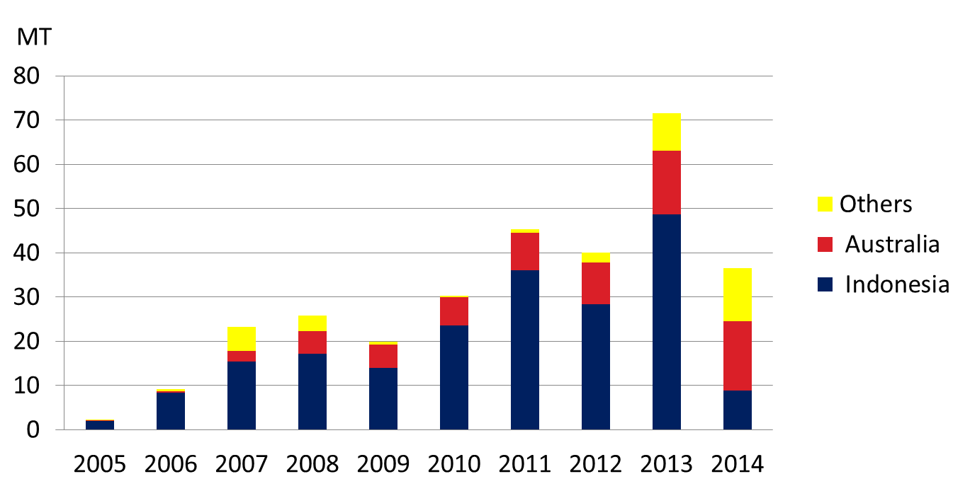
By November 2014, cumulative China bauxite imports since 2005 exceeded 300 MT
Source: trade statistics
Notes:
304MT cumulative by end 2014

Slide 4
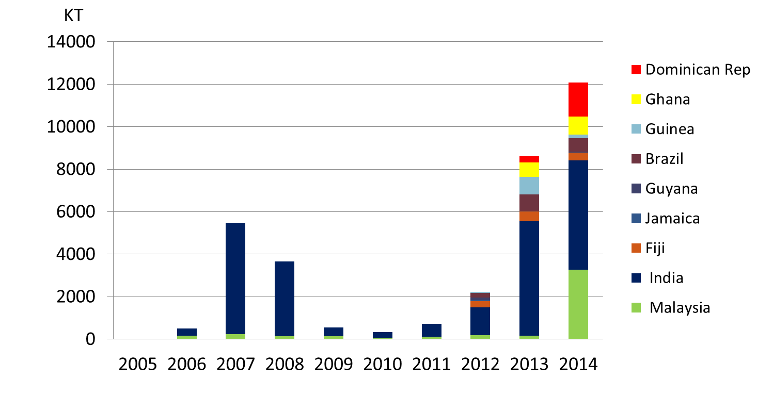
Looking more closely at the ‘others’
Source: trade statistics

Slide 5
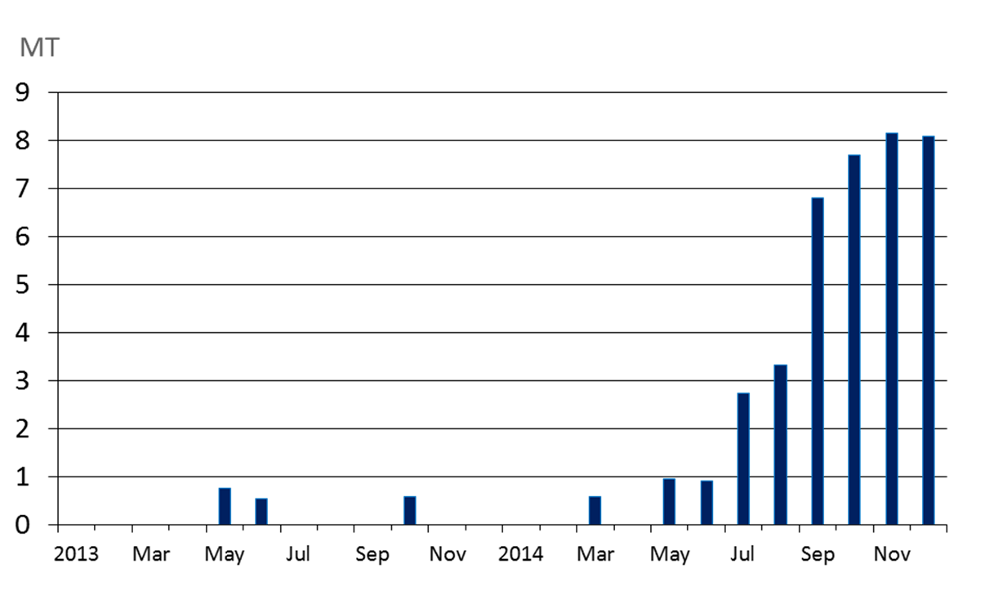
Eyes shift to Malaysia – annualised Chinese bauxite imports
Source: HMEL

Slide 6
The search continues … a non-exhaustive list
Country | Company | Remarks
Ghana | Bosai | 800kt in 2014. Capacity nearer 3Mt?
Fiji | Xinfa | 375kt in 2014, 1.5Mt 2012-2014.
Malaysia | Tanah Makumur’s Ladang Bukit Goh, and others. | 8MT annualised in December 2014 - 10MT in 2015? 20MT in 2016? (That would stabilise the stockpile.)
Laos | Yunnnan | Early days. Integrated mine-refinery.
Guinea | Hongqiao, others | Expect other Chinese participation
Australia | Glencore | Aurukun, or others, or j-v, maybe.
Jamaica | Nobel | Alumina.
Source: HMEL

Slide 7
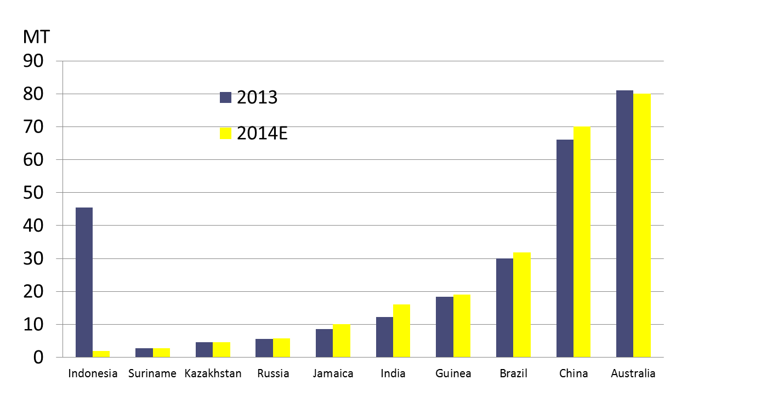
Metallurgical bauxite output by country 2013 and 2014
Source: company reports, HMEL

Slide 8
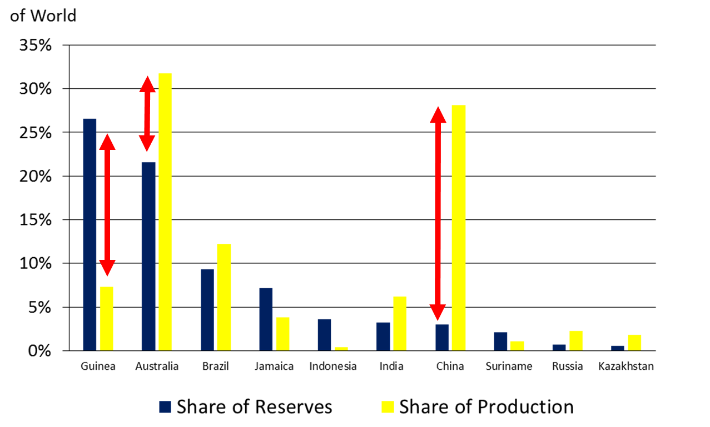
Increasing the mismatch between reserves and production
Source: HMEL

Slide 9
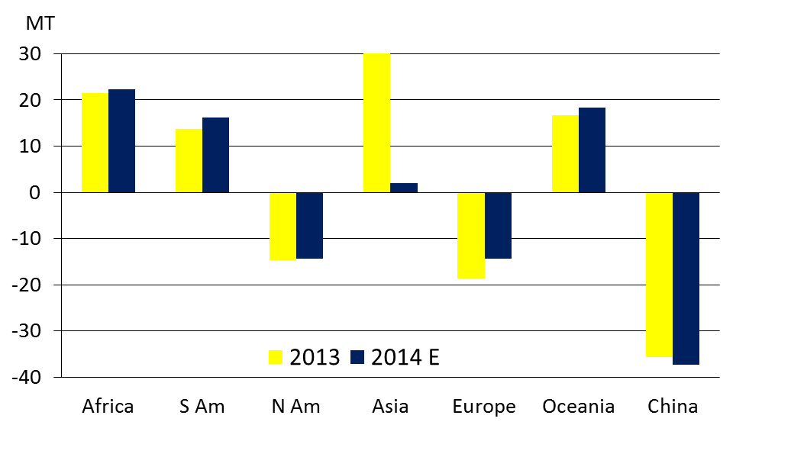
Regional bauxite balances, 2013 and 2014
Source: HMEL

Slide 10
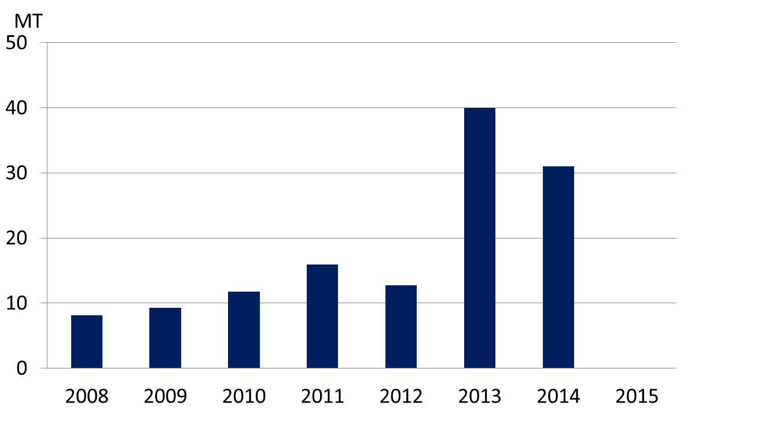
What’s happening to China’s ‘bauxite stockpile’?
Import level 2015
46 MT
43 MT
36 MT
Source: HMEL
Notes:
32M at end 2014.
With 36MT imports (same as 2014) stocks fall to 20MT; 43MT (Malaysia exports 10MT) stocks fall to 27MT; 46MT stocks stay at 31MT

Slide 11
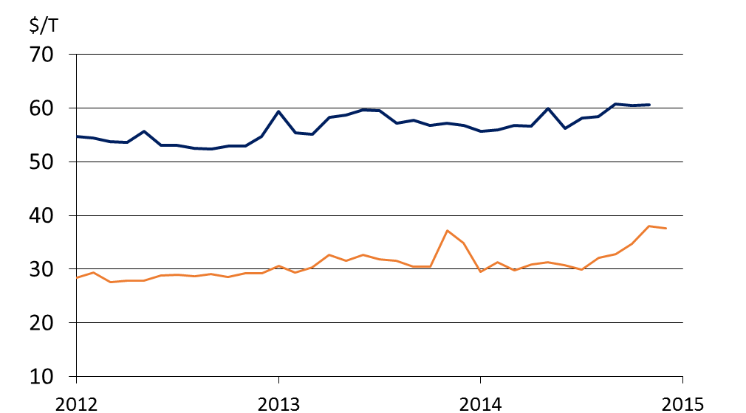
CIF bauxite prices from Australia benefit from weaker freight
Source: trade statistics

Slide 12
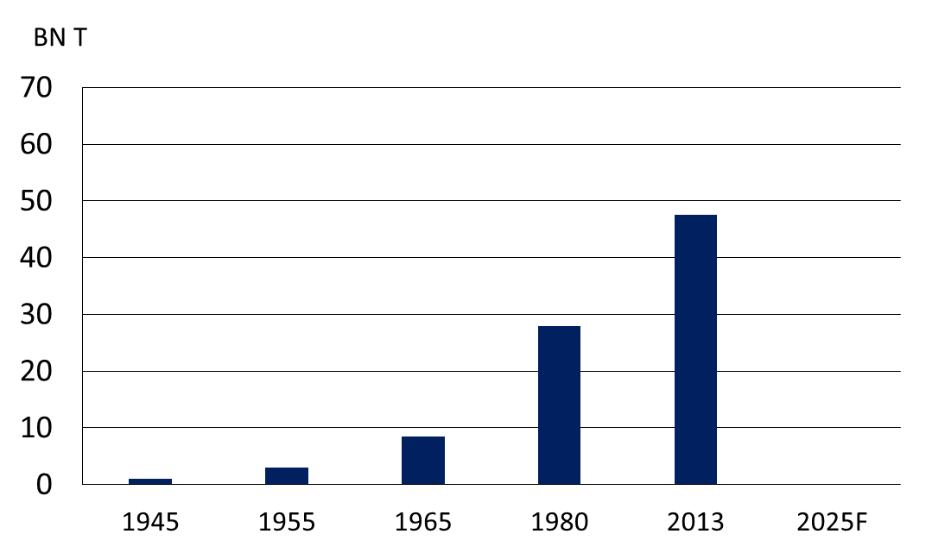
The world’s bauxite ‘reserves’ have increased immensely over the past 70 years – what direction now?
?
Source: USGS, HMEL, others. ‘Mid-range’ definition.
Notes:
1945 1; 1955 3; 1965 9; 1980 28; 2013 48 (28-67); 2025 58 (34-81)

Slide 13
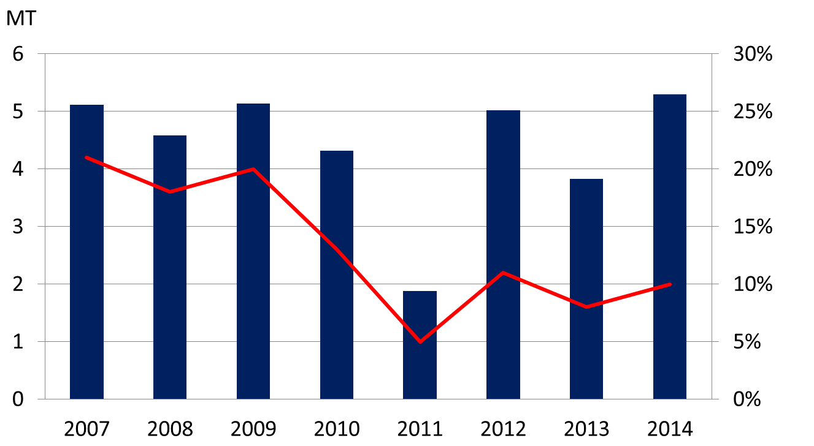
China’s alumina imports reached a new high (just) in 2014 – but not as a proportion of total demand
Source: trade statistics, HMEL
Notes:
5.3MT in 2014

Slide 14
HMEL Details
Established in January 2013.
Privately owned company, with Martin Haller as director.
Providing research and consulting services to the bauxite, alumina and aluminium industries.
Martin has 25 years experience in the metals industry, ranging from research, consulting, financial analysis and working in-house at major metals & mining companies and financial institutions. Full CV available on request.

Slide 15
Capabilities
Expertise in:
Bauxite, alumina and aluminium industry dynamics.
End-use demand and market outlook, including wire rod, extrusions and flat rolled products.
Asset modelling.
Model verification.
Bespoke research into less well understood areas of the market.
Industry workshops and presentations.

Slide 16
Client List
Includes:
FT Live
Gorham & Partners
Wood Mackenzie
Metal Bulletin Research
AlphaSights
Coleman
GL Group
Kallanish
Government agencies
Industry associations

Slide 17
Martin Haller CV
Martin holds degrees in economics from Bath University, BSc (Hons) and Manchester University, MA (Econ).
1989-1995: Senior Consultant in the aluminium team at CRU; specialising in aluminium consumption, including the markets for extruded, flat rolled and cast products.
1995-1999: Financial analyst at Kleinwort Benson (Dresdner Bank); Manager of Mining and Steel Equities Research.
1999-2000: Mergers & Acquisitions team at Billiton; working on non-exchange bulk commodities.
2000-2012: Research Manager at Brook Hunt/Wood Mackenzie; specialising in aluminium. Over this period, visiting over 100 aluminium operations, conducting research, financial and strategic analysis.
2013: HMEL established.

